Slide 1

2025 Annual Board Meeting October 19, 2025
Jim Williams- President

Slide 2
Agenda
Call to Order
President’s Report – Jim Williams
Treasurer’s Report – John Baker
Softball Report – JJ McClintock
Baseball Report – Doug White
Membership Comments
Election of Directors
3 year terms – 7
2 year terms-1
1 year terms-1
Closing Remarks

Slide 3
President’s Report

Slide 4
2025 Staff
Robin Speight – Park Administrator
Chuck Hagar – Head Groundskeeper
Joni Wood – Concession Manager
Todd Mullins – Baseball Umpire In Charge
Michael Hale – Softball Umpire In Charge

Slide 5
2025 Board of Directors
LAST NAME | FIRST NAME | COMMITTEE CHAIRS
Williams | Jim | President
Drewnowski | John | Vice President
Baker | John | Treasurer
Clay | Mandy | Secretary
Prater | Chris | Tournament Director
McClintock | JJ | Softball Director/Softball Equip.
White | Doug | Baseball Director/BaseballEquip.
Blackburn | Brad | Ethics
Sowell | Uri | Fundraising
Bauman | Ben
Hagar | Troy

Slide 6
2025 Board of Directors
Last Name | FIRST NAME | COMMITTEE CHAIRS
Kennedy | David
Kupchik | Tim | Ethics
Mayo | James
New | Collin
Robinson | Craig
Schornr | Alexis
Treece | Travis
Turner | Brent | Assistant Baseball Director
Witt | CJ

Slide 7
2025 Notable Events

Slide 8
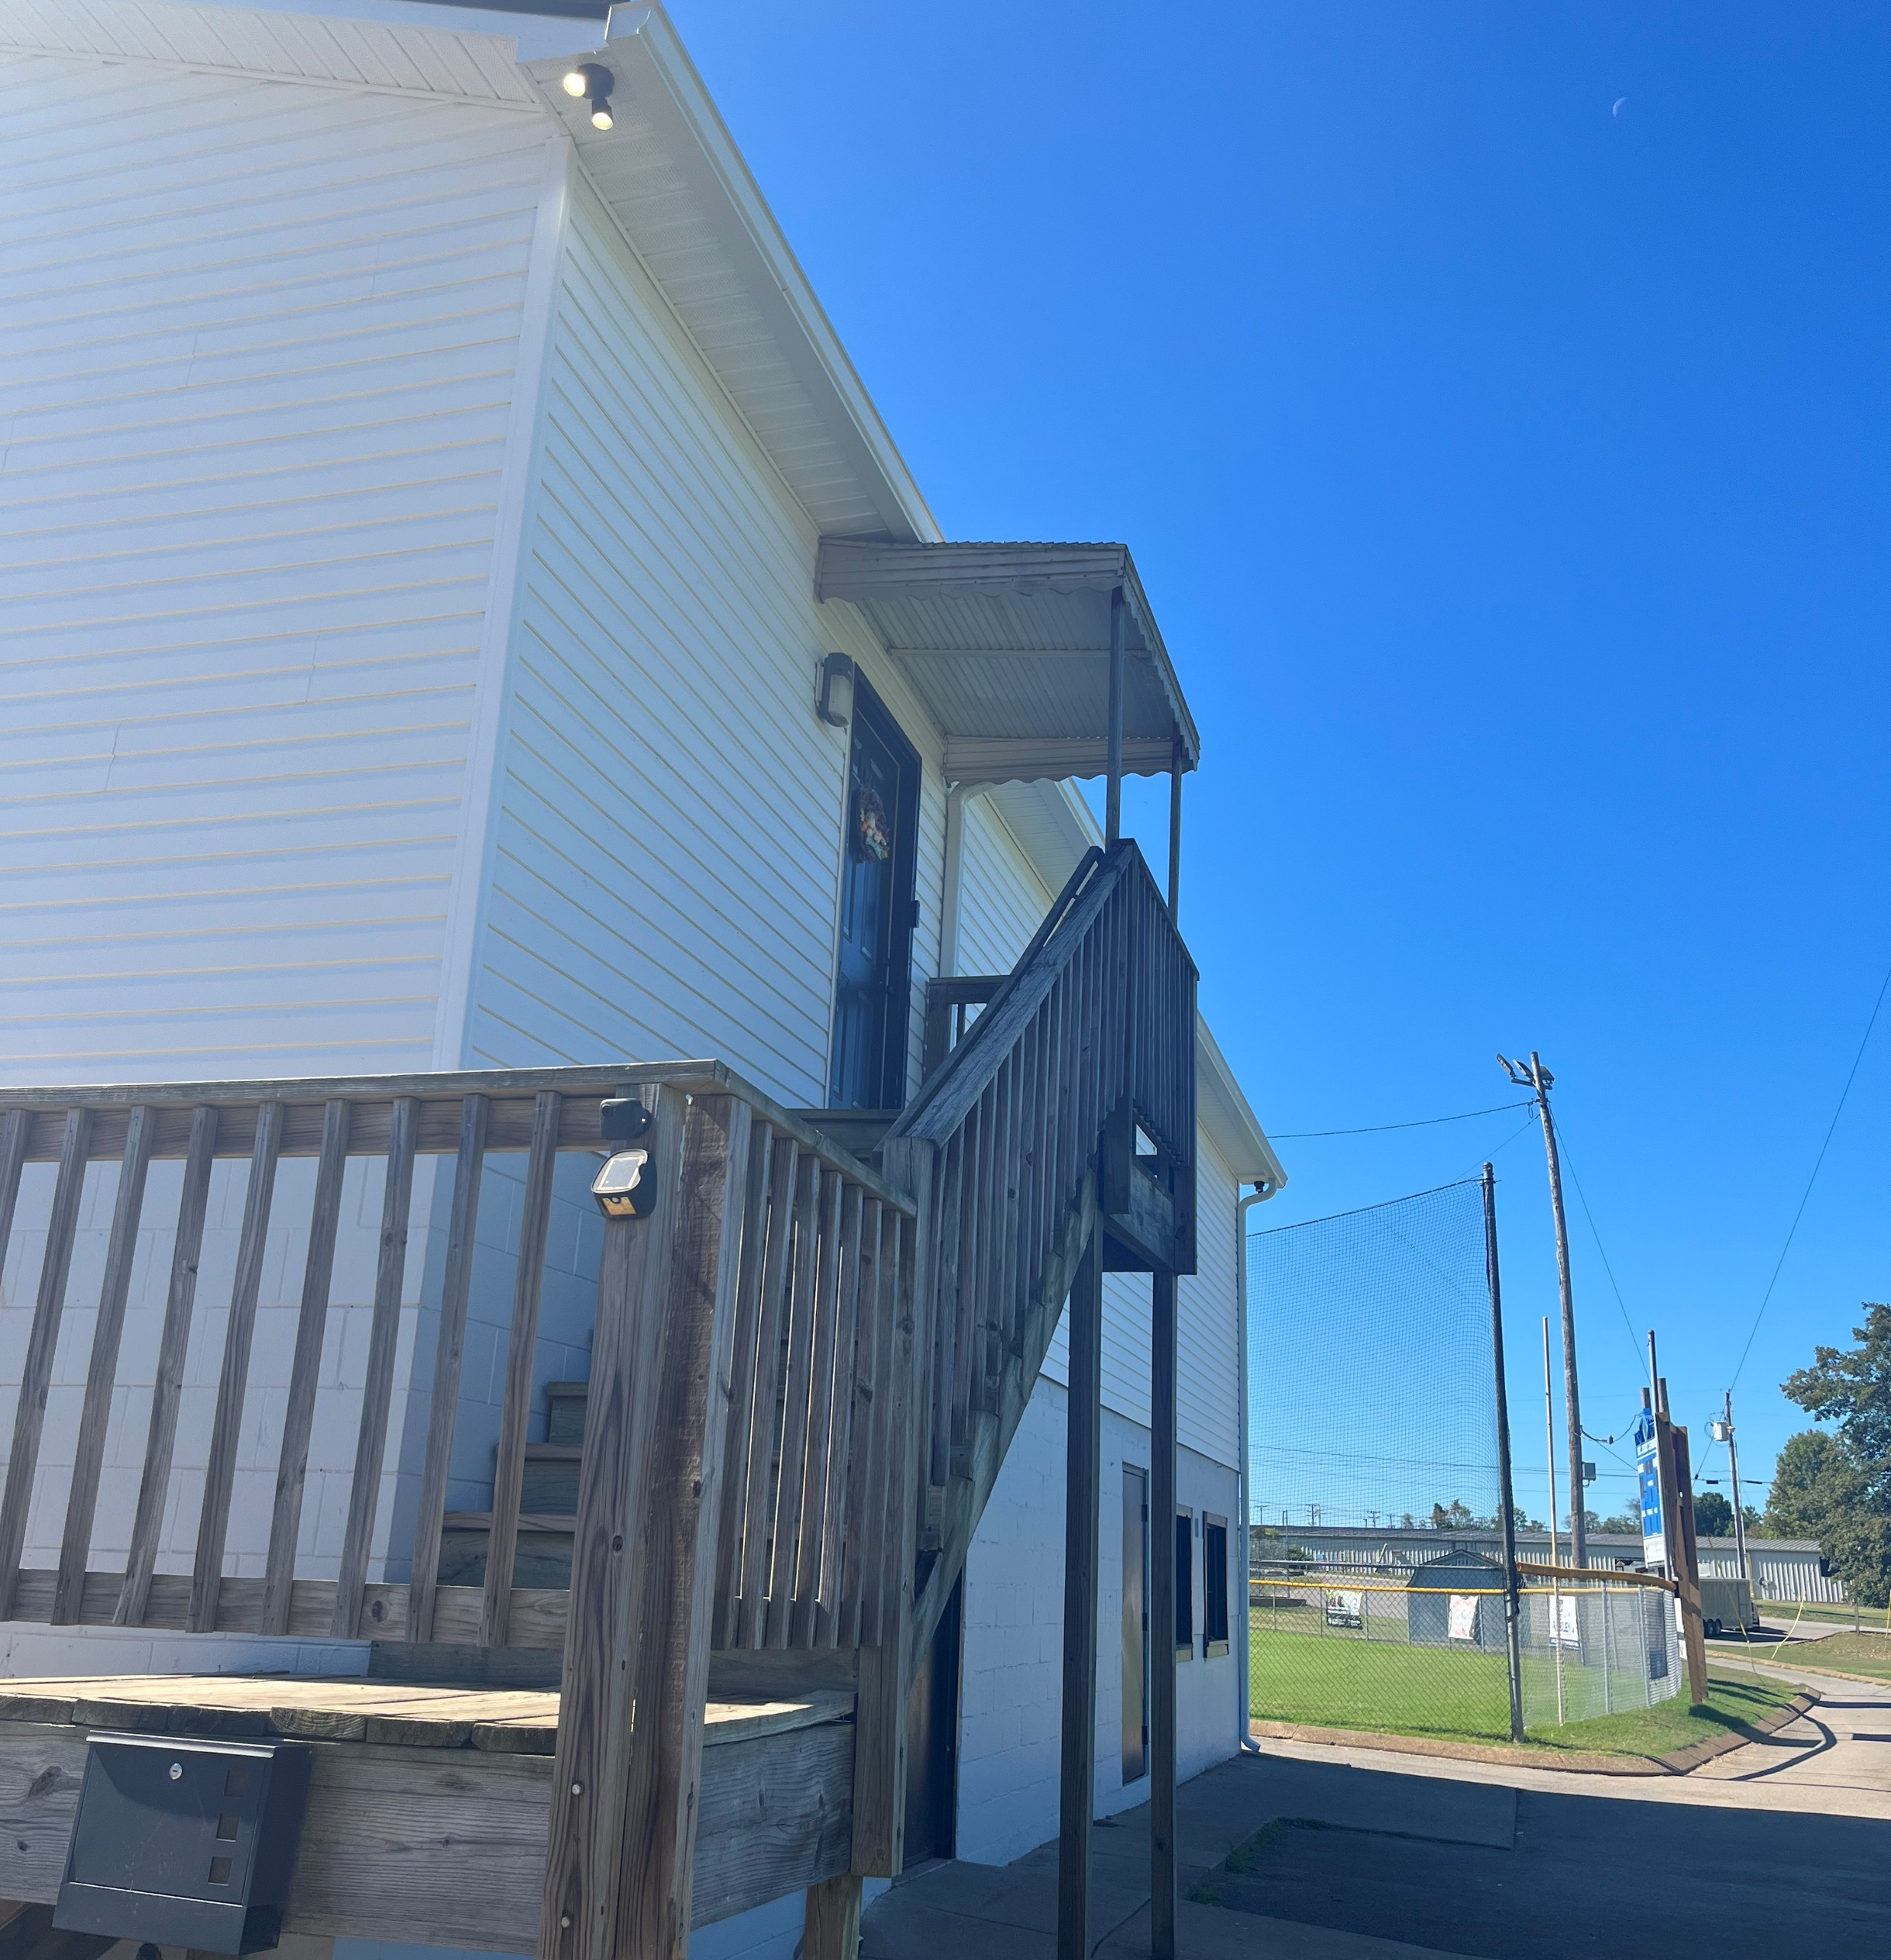
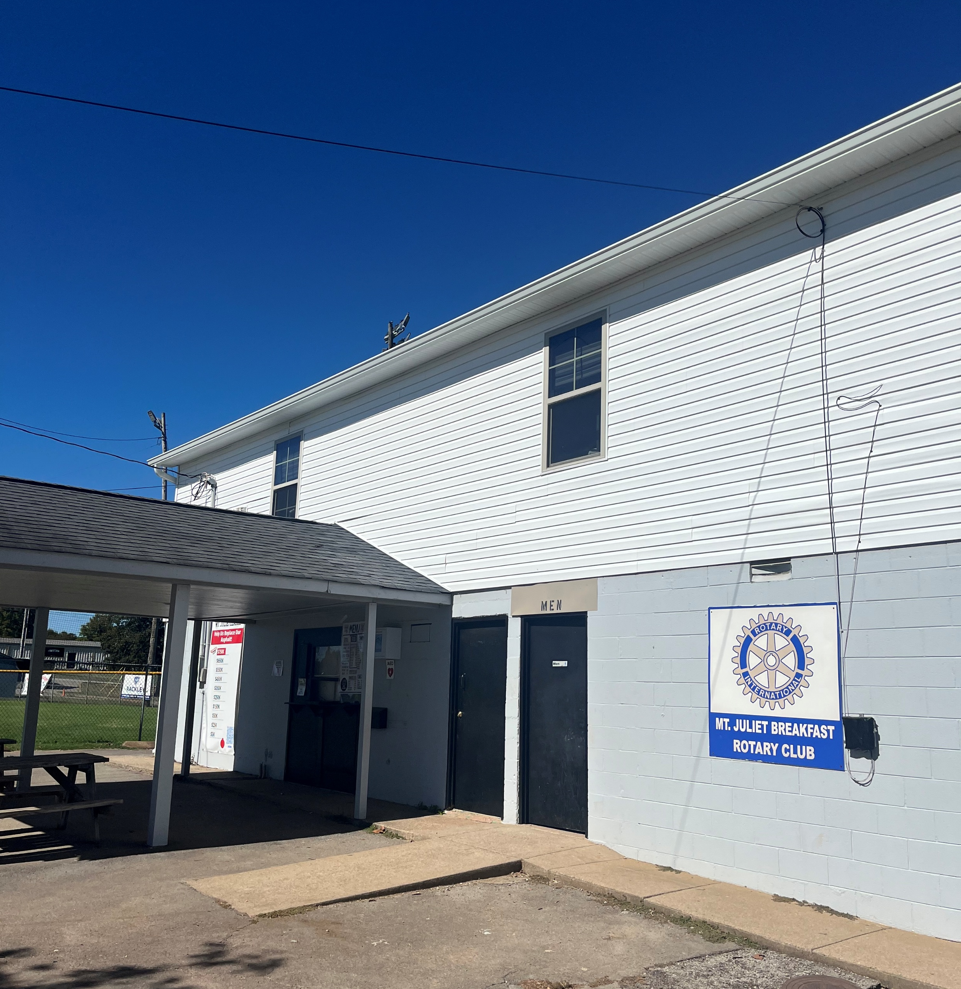
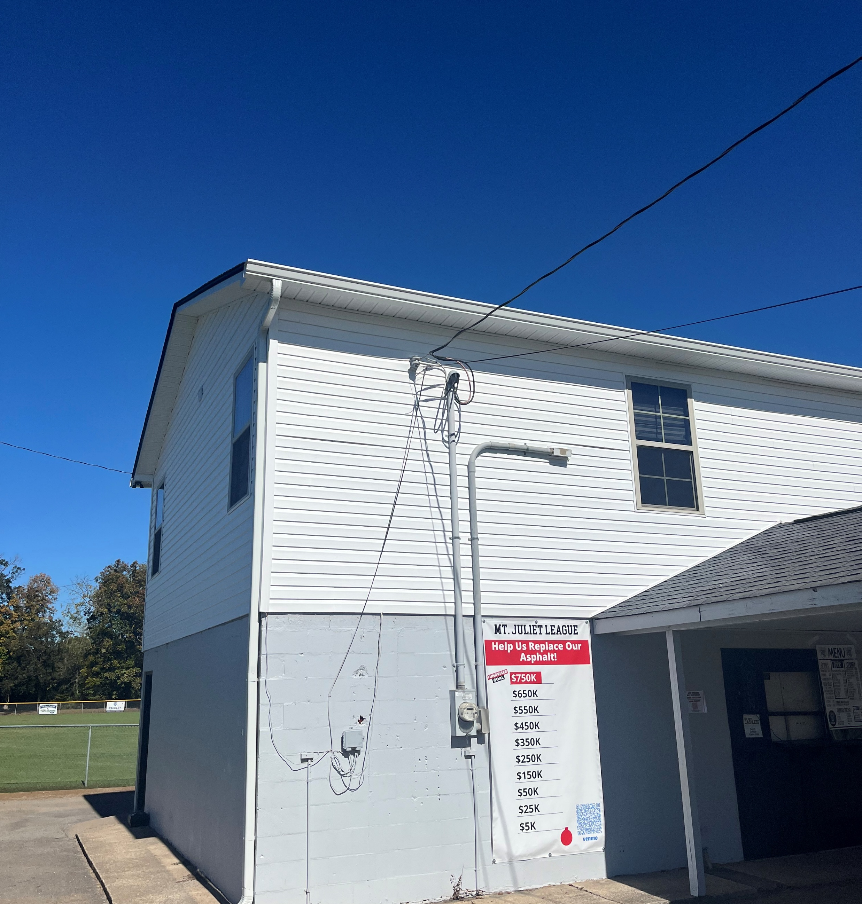
New Siding in Partnership with Onyx Roofing and Construction

Slide 9
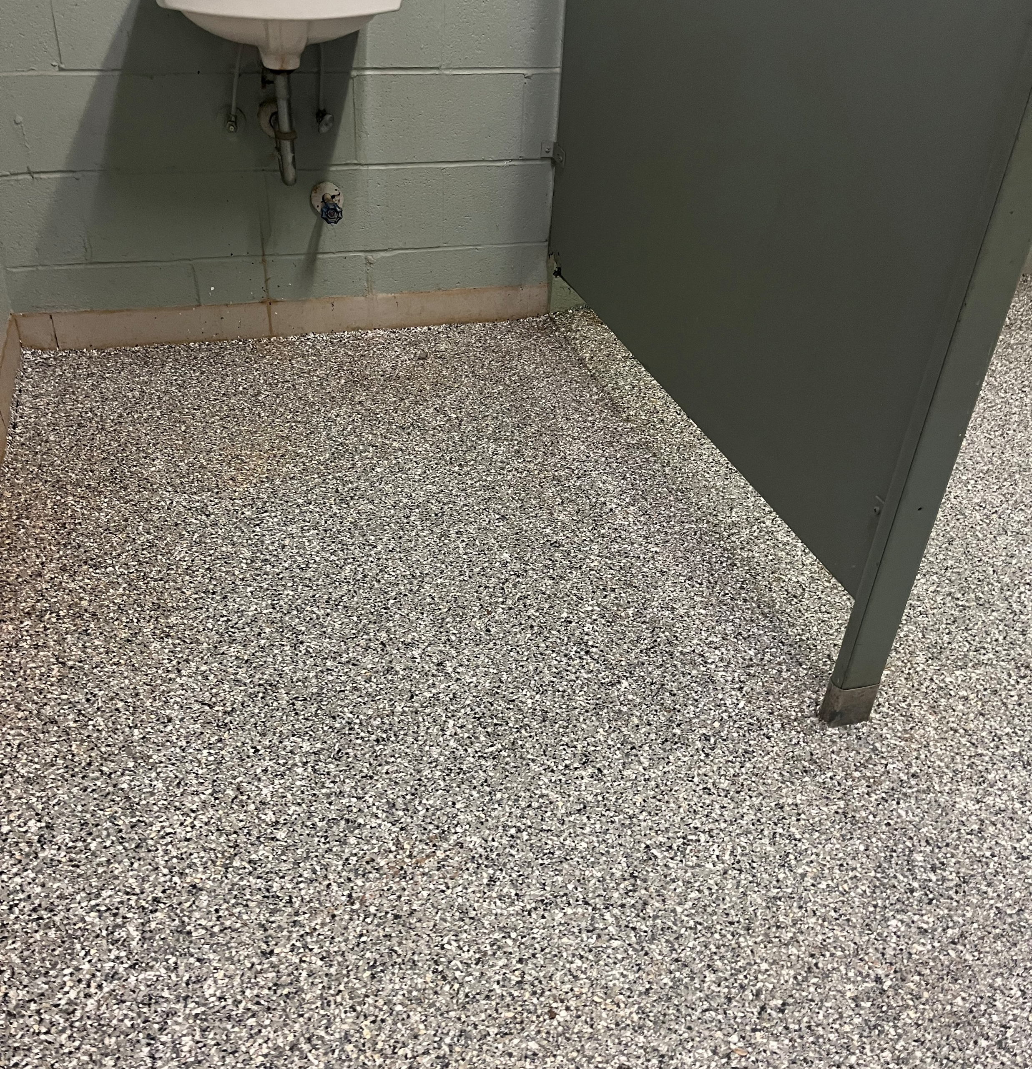
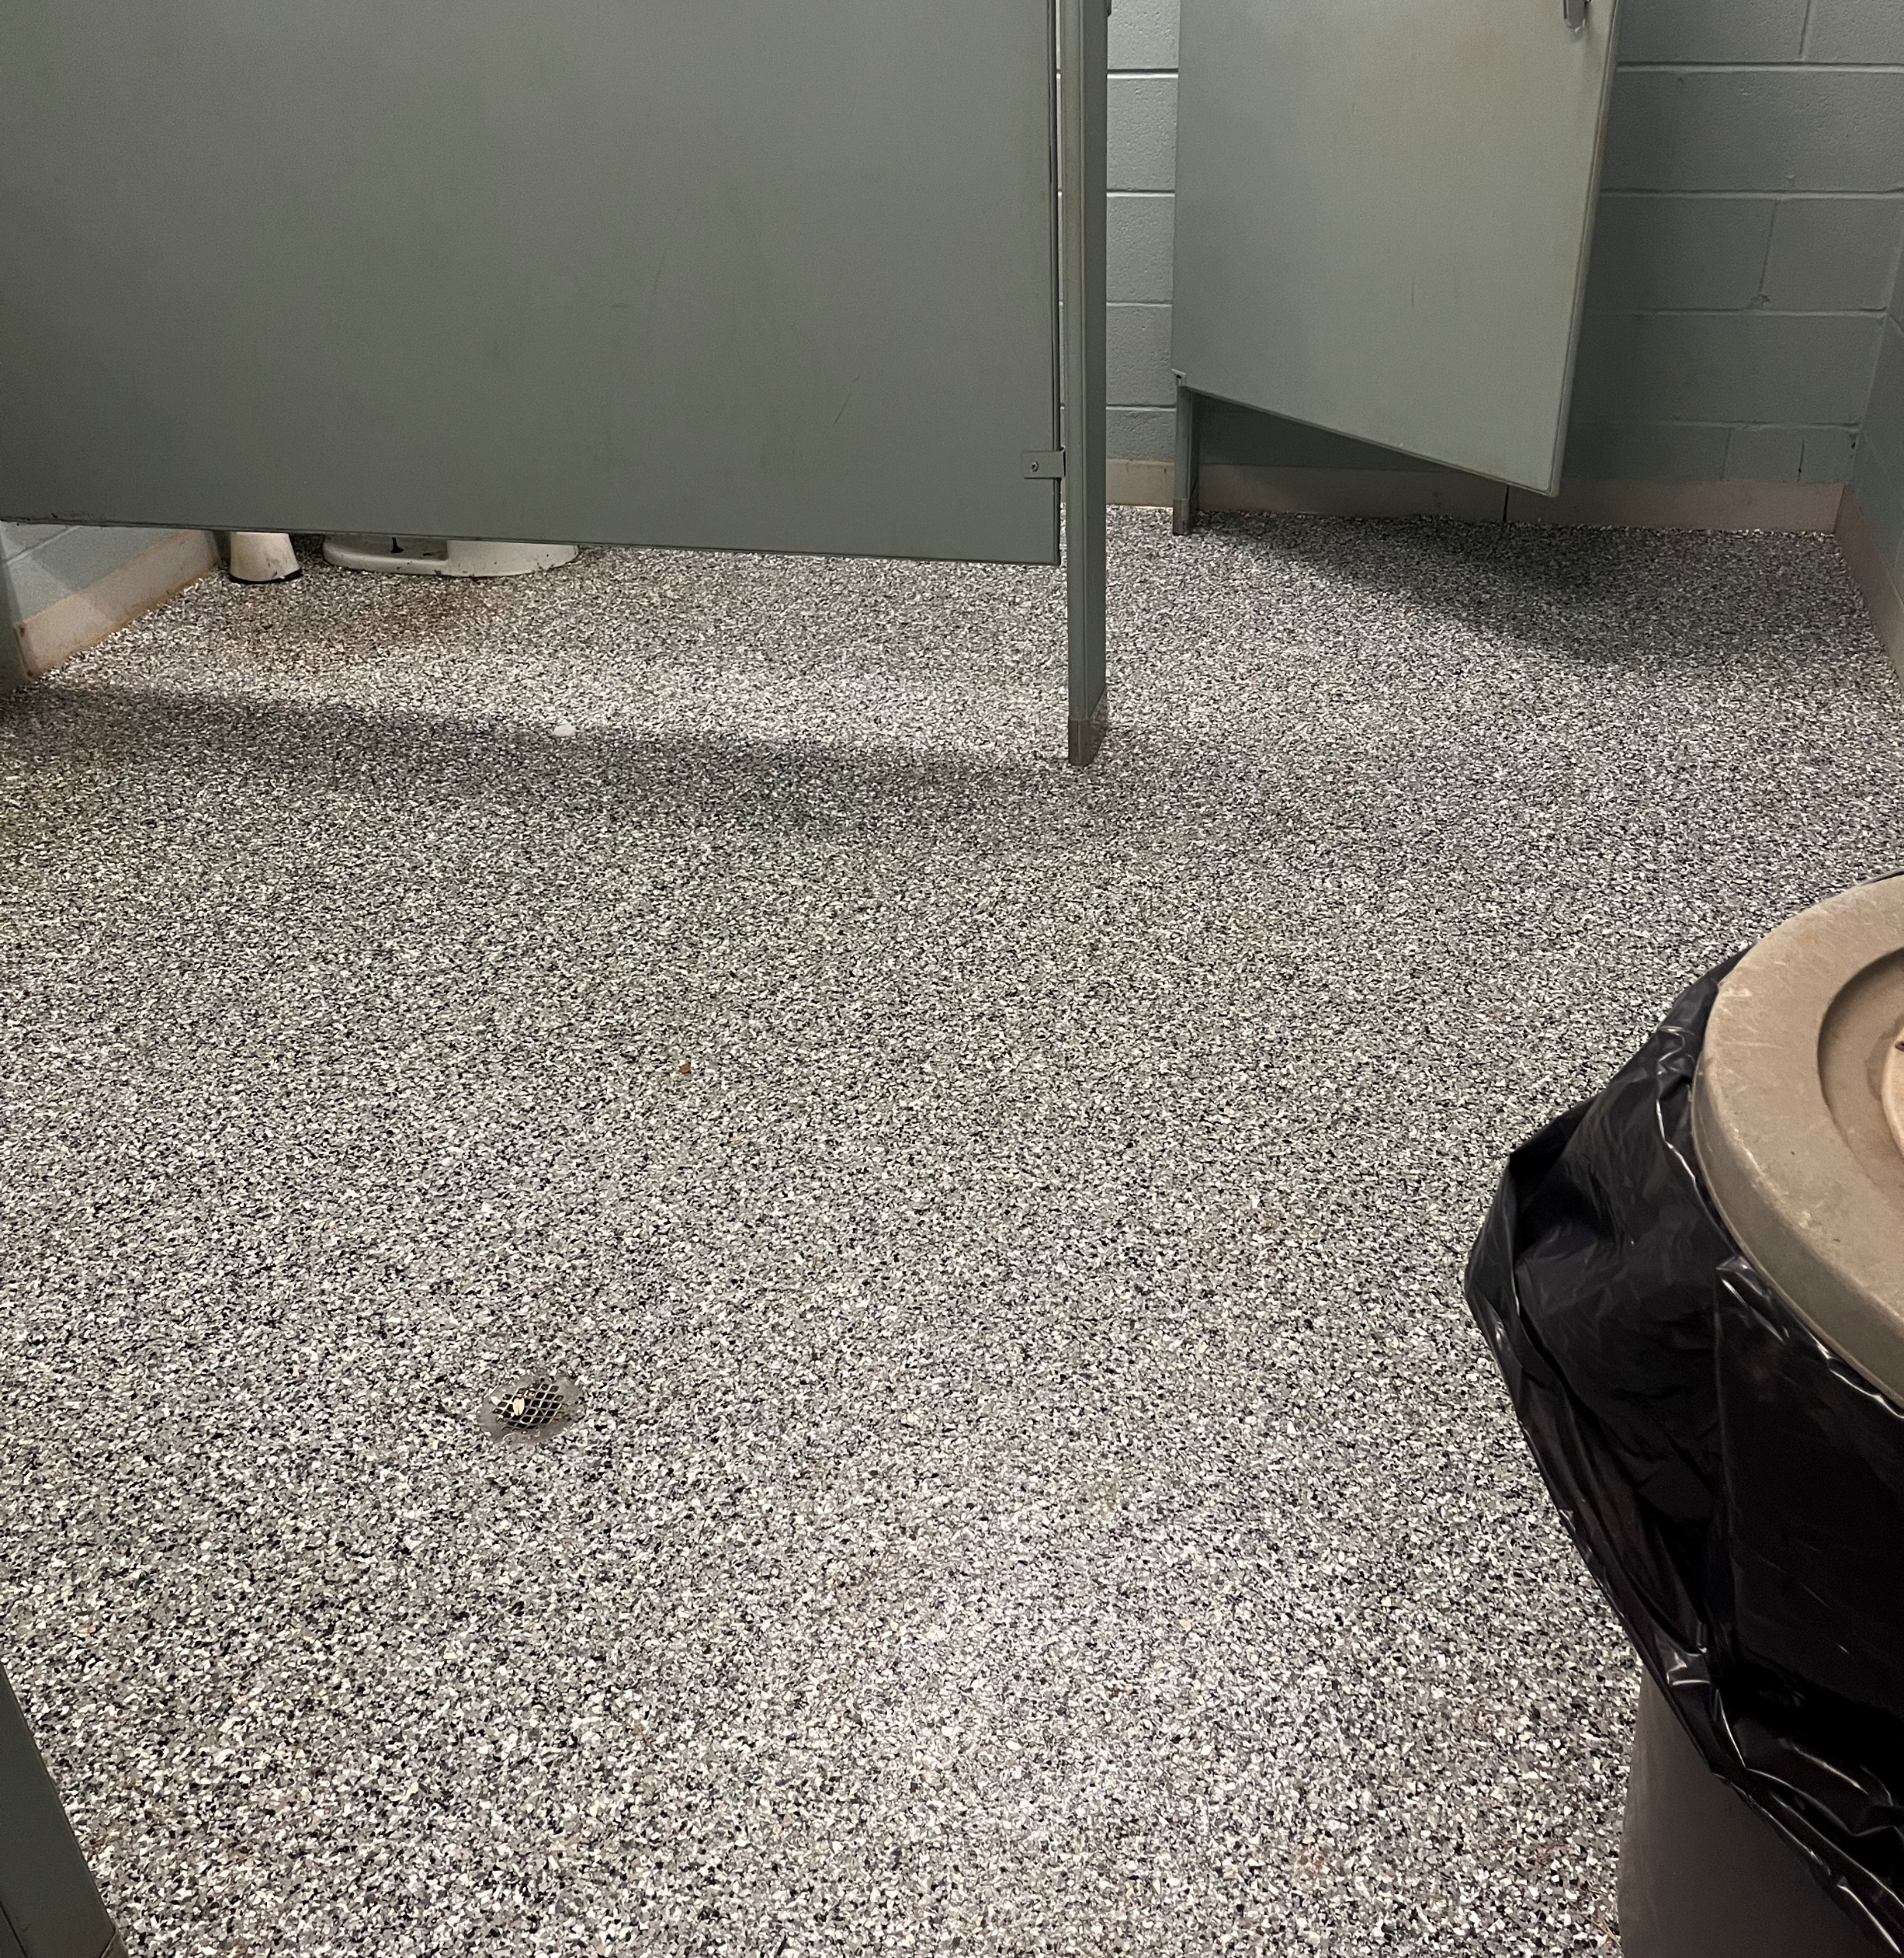
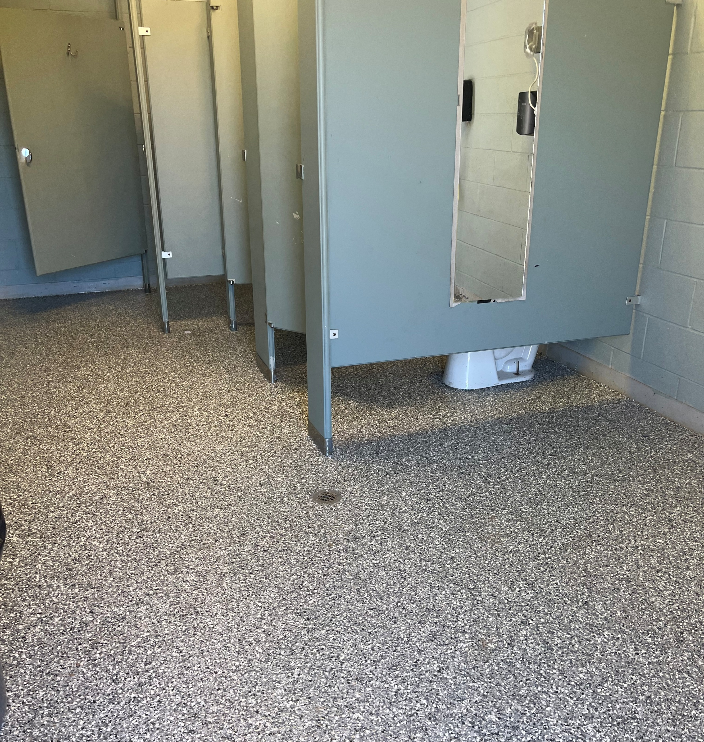
Upgraded middle quad bathroom floors in partnership with Epoxy-Crete Flooring solutions

Slide 10
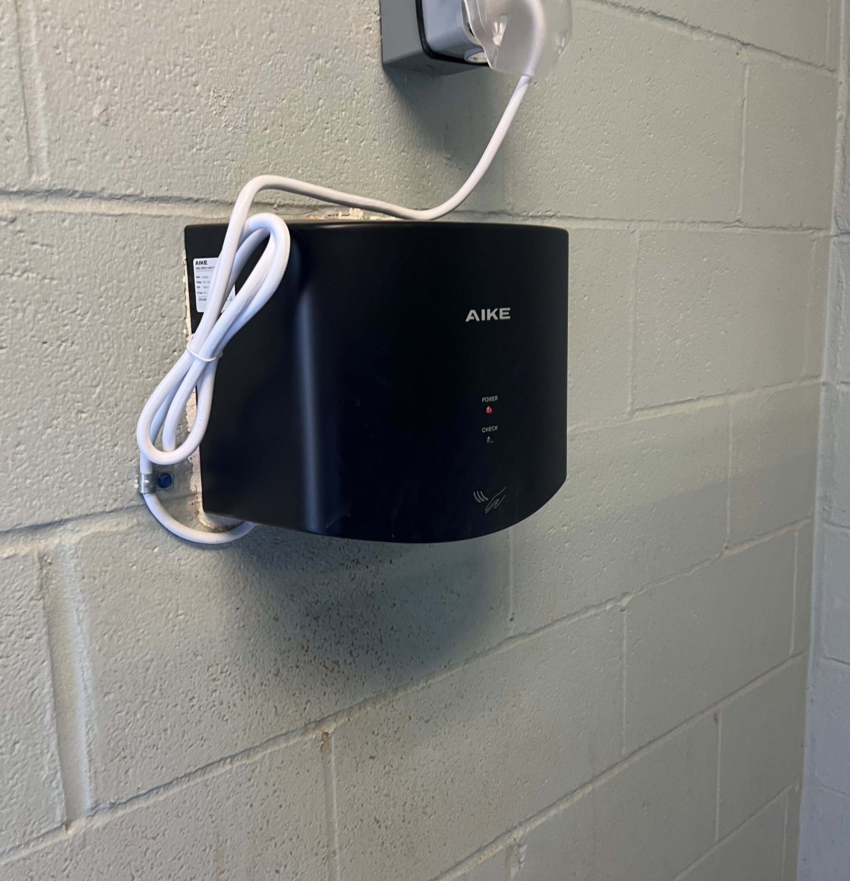
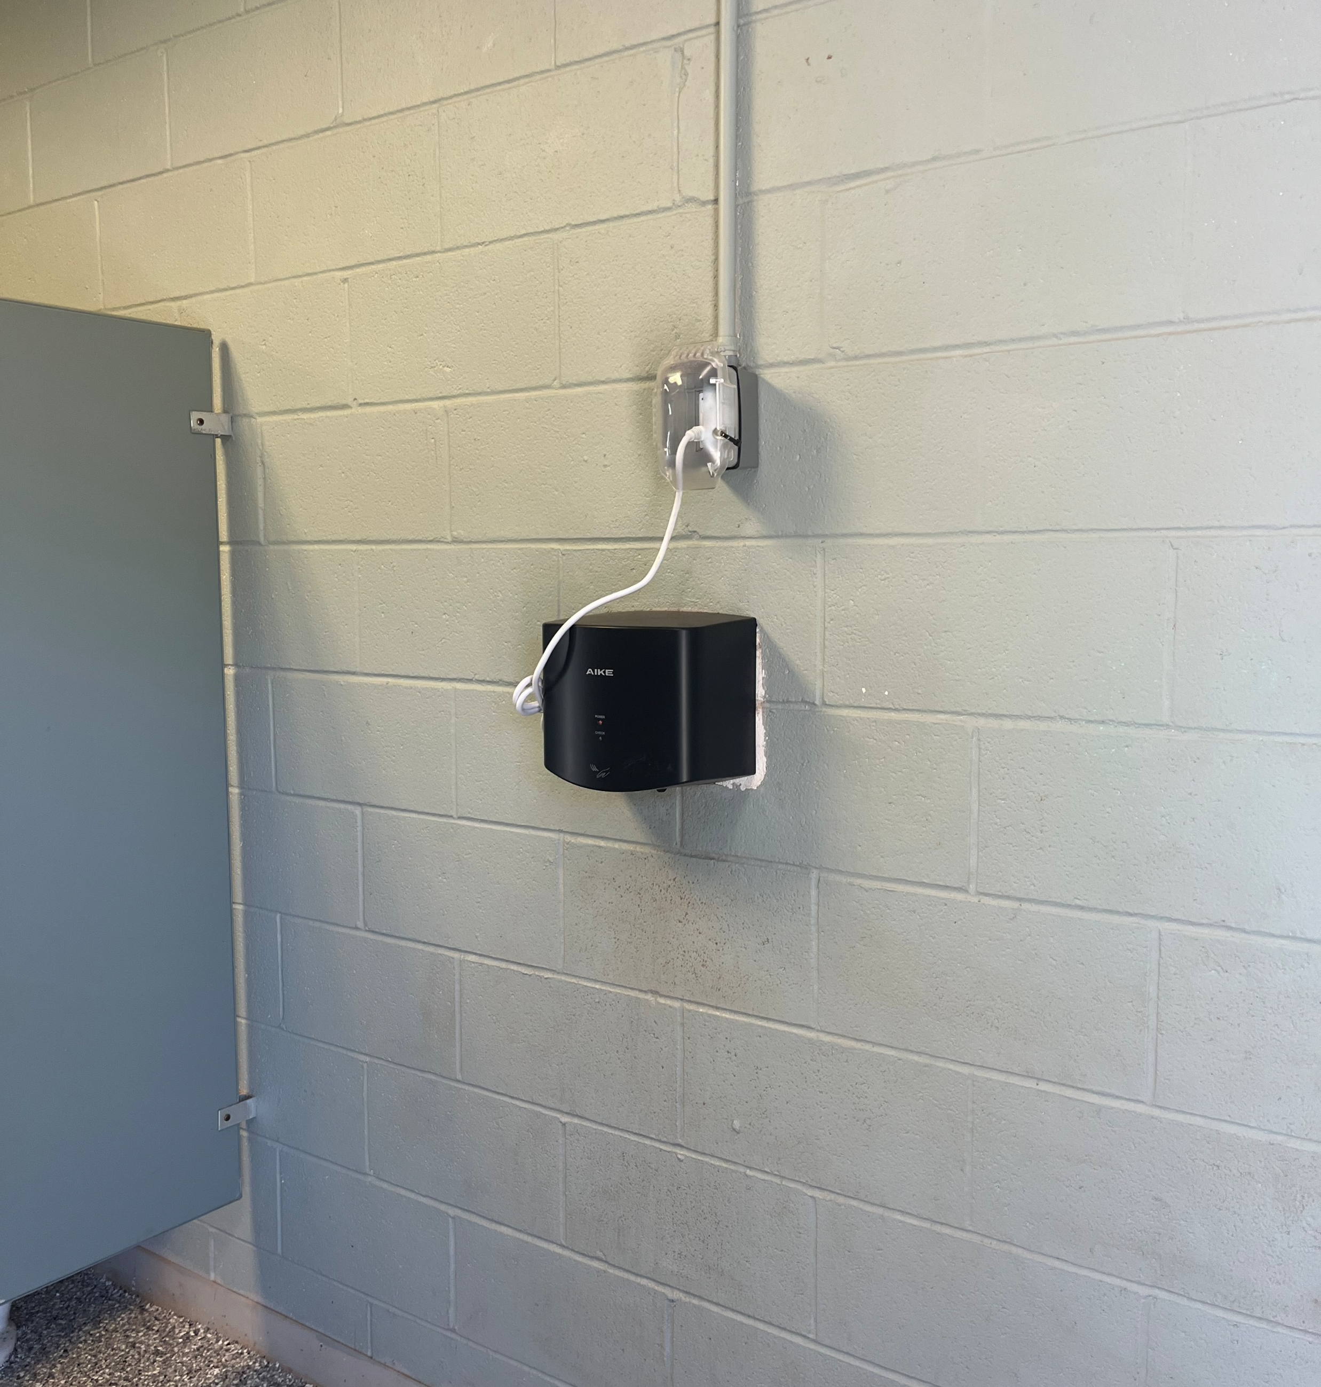
Upgraded hand dryers in all bathrooms

Slide 11
Treasurer’s Report

Slide 13
S. B. O. C. Report JJ McClintock - Director

Slide 14
2025 SPRING SOFTBALL REC CHAMPIONS
LEAGUE | CHAMPIONS
Pee Wee Gold | Marlins
Pee Wee Silver | Royals
Minor | Astros
Major | Giants
Senior | Diamondbacks
S.B.O.C. Director
JJ McClintock

Slide 15
B. B. O. C. Report Doug White

Slide 16
2025 SPRING Baseball REC CHAMPIONS
LEAGUE | CHAMPIONS
Pee Wee 6 Gold | Guardians
Pee Wee 6 Silver | mets
Pee Wee 7 | Dodgers
Pee Wee 8 | Braves
Minor 9 | Rockies
Minor 10 | Nationals
Major | Astros
Junior | Dodgers
Senior | Rays
B.B.O.C. Director
Doug White

Slide 17
Membership Comments/Questions

Slide 18
Election of Director’s

Slide 19
Board of Directors Term Expiration
LAST NAME | FIRST NAME | TERM EXPIRATION
Baker | John | 2026
Bauman | Ben | 2026
Blackburn | Brad | 2026
Clay | Mandy | 2026
Drewnowski | John | 2027
Hagar | Troy | 2025
Kennedy | David | 2027
Kupchik | Tim | 2025
Mayo | James | 2025

Slide 20
Board Of Directors Term Expiration
LAST NAME | FIRST NAME | TERM EXPIRATION
New | Collin | 2026
Prater | Chris | 2025
Robinson | Craig | 2027
Schorner | Alexis | 2025
Sowell | Uri | 2027
Treece | Travis | 2027
Turner | Brent | 2027
White | Doug | 2025
Williams | Jim | 2025
Witt | CJ | 2026

Slide 21
3 Year Terms – 7 2 Year Terms – 1 1 Year Terms - 1

Slide 22
2025 Nominations Chris Prater Jessica Neider Tim Kupchik Alexis Schorner Doug White Jim Williams Adam Holt Mike Watson Karla Ramirez Troy Hagar Steven Beard Andy Lawson

Slide 23
Election of Directors 2025 Board of Directors with Terms (in no particular order)
2028 | 2026 | 2027
Doug White | John Baker | John Drewnowski
Tim Kupchik | Ben Bauman | Craig Robinson
Steven Beard | Brad Blackburn | Brent Turner
Adam Holt | Mandy Clay | Andy Lawson
Chirs Prater | Alexis Schorner | David Kennedy
Jim Williams | Collin New | Uri Sowell
Karla Ramirez | Cj Witt | Travis Treece

Slide 24
Closing Remarks
The next board meeting will be Wednesday, November 12, 2025 at 7:00 PM at the park office. Board meetings are open to the public.
Monthly Board Meetings are the 2nd Wednesday of each month at 7:00.
Motion to Adjourn

